Slide 1
Introduction to Computer Programming Lecture 4.3:
Recursive Functions
Hemma Philamore
Department of Engineering Mathematics

Slide 2

Recursive Function
Recursive functions are functions that call themselves.
Recursion can help solve complex problems by breaking them up into smaller parts.
Example:
A function pow(x, n) that raises x to a natural power (1, 2, 3 …) of n
(multiplies x by itself n times).
pow(2, 2) = 4
pow(2, 3) = 8
pow(2, 4) = 16

Slide 3
Recursive Function
Recursive functions are functions that call themselves.
Every recursion has two basic parts:
A way to reduce the problem to something smaller and similar (calls itself to solve the subproblem)
A condition to stop the recursion (often to return a trivial solution)
pow(2, 1) = 2
Stops the program from entering infinite recursion loop.

Slide 4
Recursive Function
Iterative
Recursive
def pow(x, n):
result = 1;
// multiply result by x n times for i in n:
result *= x
return result
pow(2, 3)
def pow(x, n):
if (n == 1):
return x
// multiply result by x n times
else:
return x * pow(x, n-1)
pow(2, 3)
condition to end recursion
call function with a simpler version of the problem
8
8

Slide 5
When pow(x, n) is called, the following control flow executes:
function pow(x, n):
if (n == 1):
return x
// multiply result by x n times
else:
return x * pow(x, n-1)
pow(2, 3)
pow(x, n)
Recursive call until n==1
YES
NO
x * pow(x, n-1)
n==1 ?
x

Slide 6

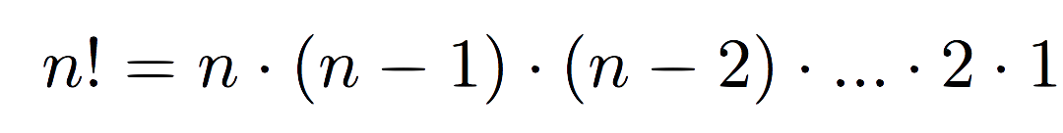
Recursive Function
Every recursion has two basic parts:
A way to reduce the problem to something smaller and similar (calls itself to solve the subproblem)
A condition to stop the recursion (often to return a trivial solution)
Example: Factorial
condition to end recursion

Slide 7

Example: Factorial
condition to end recursion
$$0!=1$$
Notes:
Forgot to mention that 0! = 1

Slide 8
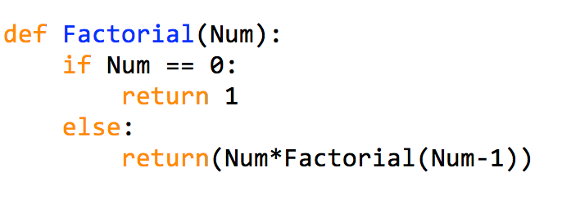
Recursive Function
condition to
end recursion
call function again with a
simpler version of the
problem
>>> Factorial( 0 )
1
>>> Factorial( 1 )
1
>>> Factorial( 2 )
2

Slide 9
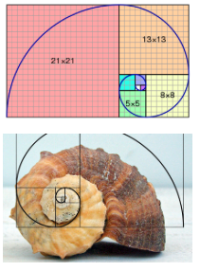


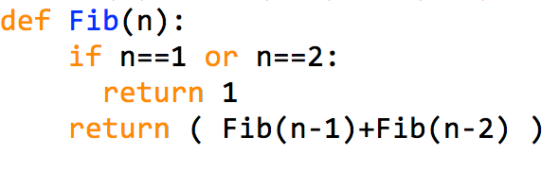

Recursive Function
Example: Fibonacci
$$f\left(n\right)=f\left(n−1\right)+f(n−2)$$
recursive
definition
stopping conditions
condition to
end recursion
Recursive
definition
condition to
end recursion
Notes:
Cut off at the end

Slide 10
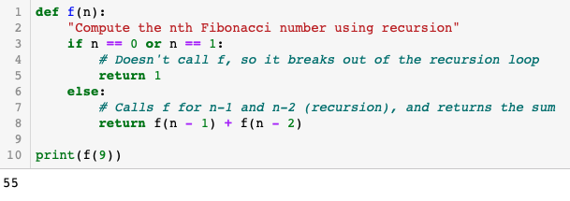

Slide 11
Recursive Function
There exists an alternative
non-recursive implementation with a loop
Can you think what this implementation would look like?

Slide 12
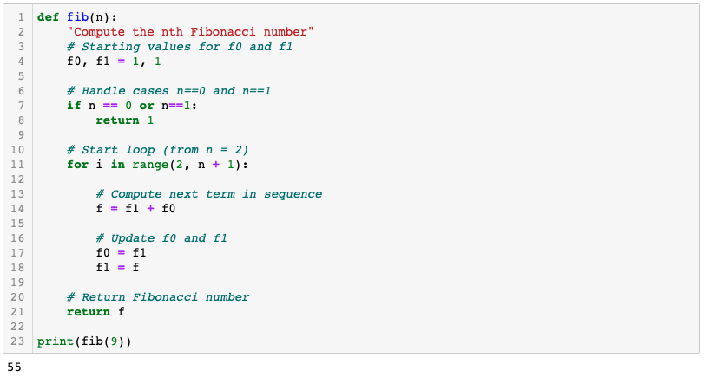
What would this look like?

